Slide 1
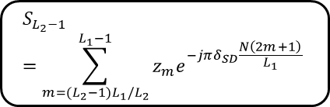

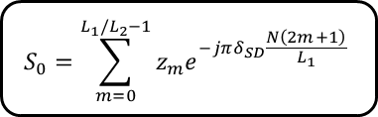





Received data stream
Buffer
A frame of data
Frequency estimate of SD (Shift register, FFT)
Phasor estimate of SD
Detector
$$z_{0}=\sum_{n=0}^{N/L_{1}−1}{r_{n}s_{n}^{∗}}$$
Shift register of size $N/L_{1}$
$$S_{0}=\sum_{m=0}^{L_{1}/L_{2}−1}{z_{m}e^{−jπδ_{SD}\frac{N\left(2m+1\right)}{L_{1}}}}$$
$$z_{1}=\sum_{n=N/L_{1}}^{2N/L_{1}−1}{r_{n}s_{n}^{∗}}$$
Time synchronization
Shift register of size $N/L_{1}$
Carrier synchronization
$$z_{L_{1}−2}=\sum_{n=(L_{1}−2)N/L_{1}}^{(L_{1}−1)N/L_{1}−1}{r_{n}s_{n}^{∗}}$$
Shift register of size $N/L_{1}$
$$S_{L_{2}−1}=\sum_{m={(L}_{2}−1)L_{1}/L_{2}}^{L_{1}−1}{z_{m}e^{−jπδ_{SD}\frac{N\left(2m+1\right)}{L_{1}}}}$$
Shift register of size $N/L_{1}$
$$z_{L_{1}−1}=\sum_{n=(L_{1}−1)N/L_{1}}^{N−1}{r_{n}s_{n}^{∗}}$$
Record the results

Slide 2
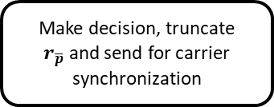
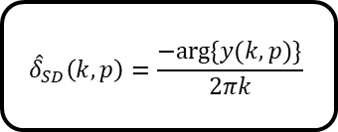
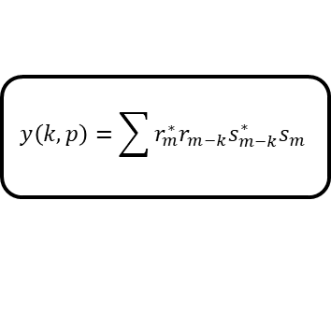




Received data stream r
Buffer
$$y\left(k,p\right)=\sum{r_{m}^{∗}r_{m−k}s_{m−k}^{∗}s_{m}}$$
$${\hat{δ}}_{SD}\left(k,p\right)=\frac{−arg⁡\{y(k,p)\}}{2πk}$$
Shift register I
$$r_{m}^{∗}r_{m−k}$$
Shift register II
$$\text{The} \text{numerator} \text{of} \text{phasor} \text{estimate} \text{for} \text{SD} ({\hat{S}}_{SD}^{(num)}(p))$$
$$ρ(p)=\frac{\left|{\hat{S}}_{SD}^{(num)}(p)\right|}{\left\|r_{p}\right\|∙\left\|s\right\|}$$
Make decision, truncate
$r_{\overline{p}}$ and send for carrier synchronization
$$\left\|r_{p}\right\|=\sqrt{\sum_{m=p}^{p+N−1}{r_{m}r_{m}^{∗}}}$$
Shift register III
Record the results, which includes
position of preamble, frequency, phase, amplitude offset estimate.
carrier synchronization
Terminate

Slide 3

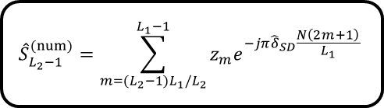

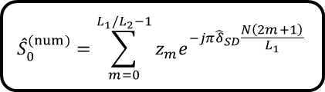




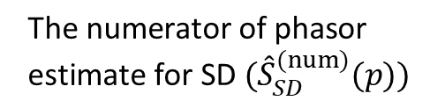

The SD estimator for frequency $({\hat{δ}}_{SD})$
Shift register of size $N/L_{1}$
$$z_{0}=\sum_{n=0}^{N/L_{1}−1}{r_{n}s_{n}^{∗}}$$
$${\hat{S}}_{0}^{(num)}=\sum_{m=0}^{L_{1}/L_{2}−1}{z_{m}e^{−jπ{\hat{δ}}_{SD}\frac{N\left(2m+1\right)}{L_{1}}}}$$
Shift register of size $N/L_{1}$
$$z_{1}=\sum_{n=N/L_{1}}^{2N/L_{1}−1}{r_{n}s_{n}^{∗}}$$
Received data r in buffer
$$\text{The} \text{numerator} \text{of} \text{phasor} \text{estimate} \text{for} \text{SD} ({\hat{S}}_{SD}^{(num)}(p))$$
Shift register of size $N/L_{1}$
$$z_{L_{1}−2}=\sum_{n=(L_{1}−2)N/L_{1}}^{(L_{1}−1)N/L_{1}−1}{r_{n}s_{n}^{∗}}$$
$${\hat{S}}_{L_{2}−1}^{(num)}=\sum_{m={(L}_{2}−1)L_{1}/L_{2}}^{L_{1}−1}{z_{m}e^{−jπ{\hat{δ}}_{SD}\frac{N\left(2m+1\right)}{L_{1}}}}$$
Shift register of size $N/L_{1}$
$$z_{L_{1}−1}=\sum_{n=(L_{1}−1)N/L_{1}}^{N−1}{r_{n}s_{n}^{∗}}$$

Slide 4



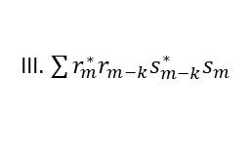


Received data stream r
I. buffer
II. $r_{m}^{∗}r_{m−k}$
VI. $\left\|r_{p}\right\|$
III. $\sum{r_{m}^{∗}r_{m−k}s_{m−k}^{∗}s_{m}}$
IV. ${\hat{δ}}_{p}$
V. ${\hat{ξ}}_{p}$
VII. $ρ\left(p\right)$
VIII. detection
IX. carrier synchronization
Record the results

Slide 5
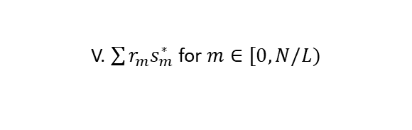




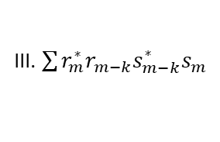
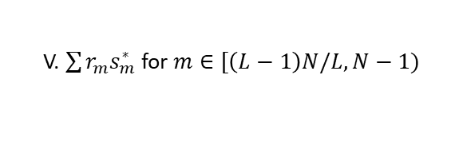

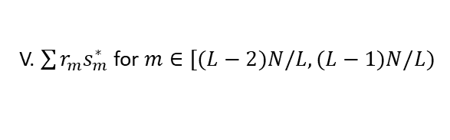

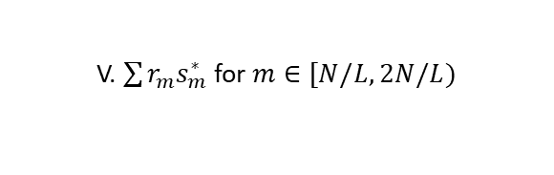
Received data stream r
I. buffer
II. $r_{m}^{∗}r_{m−k}$
III. $\sum{r_{m}^{∗}r_{m−k}s_{m−k}^{∗}s_{m}}$
IV. ${\hat{δ}}_{p}=−arg⁡\{∙\}/(2πk)$
V. $\sum{r_{m}s_{m}^{∗}}$ for $m∈[0,N/L)$
V. $\sum{r_{m}s_{m}^{∗}}$ for $m∈[N/L,2N/L)$
VI. ${\hat{ξ}}_{p}$ in (3.21)
VIII. $ρ\left(p\right)≷γ$
in (3.6)
IX. ${\hat{δ}}_{p}$ in (3.20)
Record the results
V. $\sum{r_{m}s_{m}^{∗}}$ for $m∈[(L−2)N/L,(L−1)N/L)$
V. $\sum{r_{m}s_{m}^{∗}}$ for $m∈[\left(L−1\right)N/L,N−1)$
VII. $\left\|r_{p}\right\|$

